Slide 1
Keylogger
CAPSTONE PROJECT
Presented By:
1. Muthumari S - AURCM - Computer Science and Department

Slide 2
OUTLINE
Problem Statement
Proposed Solution
System Development Approach
Algorithm & Deployment
Result
Conclusion
Future Scope
References

Slide 3
Problem Statement
In the contemporary digital landscape, safeguarding personal and confidential information stands as an imperative.
Regrettably, conventional security measures often overlook the vulnerabilities inherent in unauthorized keyboard usage.
Our project is poised to rectify this oversight by devising a system capable of monitoring keyboard activity and discerning suspicious patterns.
Through the identification and mitigation of unauthorized keyboard usage, our aim is to fortify overall security protocols and safeguard sensitive data.

Slide 4
Proposed Solution
Objective: The keylogger system aims to capture keystrokes entered by users on a keyboard to monitor their activity. This can be useful for various purposes such as parental control, employee monitoring, or debugging.
Components:
a. Data Collection: The keylogger captures keystrokes entered by the user in real-time.
b. Data Preprocessing: Since keystrokes are captured directly, there's minimal preprocessing required. However, if the captured data needs to be stored or analyzed, basic preprocessing steps like removing unwanted characters or formatting may be applied.
c. Machine Learning Algorithm: The system does not involve machine learning. Instead, it relies on basic programming techniques to capture and store keystrokes.
d. Deployment: The keylogger can be deployed on a target system discreetly, either as a standalone application or as part of a larger software package.
e. Evaluation: Evaluation of the keylogger typically involves testing its functionality, reliability, and stealthiness. This can be done through manual testing and user feedback.

Slide 5
Proposed Solution
Operation:
a. Data Collection: The keylogger intercepts keystrokes using a library like pynput.keyboard in Python. Each keystroke is captured along with relevant metadata such as timestamp and key code.
b. Data Preprocessing: As mentioned earlier, minimal preprocessing is required. However, if data analysis is intended, preprocessing steps like encoding or formatting may be applied.
c. Machine Learning Algorithm: No machine learning algorithm is involved in this system.
d. Deployment: The keylogger can be deployed on a target system manually or through social engineering techniques. It may run in the background without the user's knowledge.
e. Evaluation: Evaluation involves checking the accuracy and completeness of the captured keystrokes, as well as assessing the system's stealthiness to avoid detection by users or security software.
Result: The keylogger system provides a means to monitor user activity by capturing keystrokes. Its effectiveness depends on factors such as reliability, stealthiness, and legality of use.
Ethical Considerations: It's crucial to consider the ethical implications of deploying a keylogger, as it can potentially invade user privacy and violate laws or regulations. Proper consent and disclosure should be obtained before deploying such systems, and they should only be used for legitimate purposes in compliance with applicable laws and ethical guidelines.

Slide 6
System Approach
Requirement Analysis : Gather and analyze requirements for the keylogger, including features, security needs, and user expectations.
Design Phase :
Architecture Design : Define the overall system architecture, including components, modules, and their interactions.
Database Design : Design the database schema for storing encrypted data securely.
UI/UX Design : Create mockups and designs for the user interface, focusing on usability and intuitiveness.
Implementation :
Keylogging Module : Develop the module to capture keystrokes using platform-specific libraries.
Encryption Module : Implement encryption algorithms for securing logged data and communication.
Stealth Mode : Code the functionality to make the keylogger undetectable to users and antivirus software.
Access Control : Develop authentication mechanisms and access control features.
User Interface : Build the graphical interface for configuration and monitoring.
Compatibility : Ensure compatibility across different operating systems and input methods.
Testing :
Unit Testing : Test individual modules to ensure they function correctly.
Integration Testing : Verify that modules work together seamlessly.
Security Testing : Perform penetration testing and vulnerability assessments to identify and fix security flaws.
Compatibility Testing : Test the keylogger on various platforms and applications to ensure compatibility.
Deployment :
Prepare installation packages for different operating systems.
Provide clear instructions for installation and configuration.
Deploy the keylogger in controlled environments for initial use and feedback gathering.

Slide 7
Algorithm
1.Initialization:
Initialize an empty string variable to store the keystrokes (e.g., log).
Import necessary libraries (e.g., pynput.keyboard for capturing keystrokes).
2.Keystroke Capture:
Define a callback function (callback_function) to capture keystrokes.
3.Within the callback function:
Capture each pressed key.
Append the pressed key to the log variable.
Handle special keys such as space or shift appropriately.
4.Data Logging:
Periodically save the captured keystrokes to a file or buffer.
Implement logic to handle the maximum size of the log to avoid memory overflow.
Utilize threading to handle both keystroke capturing and email sending simultaneously.
Define a thread function (thread_function) to handle the email sending task.
5.Keylogger Activation:
Create a listener for keyboard events using the library (e.g., pynput.keyboard).
Start the listener to capture keystrokes in real-time.
6.Execution:
Start the main loop to run the keylogger indefinitely.
Handle keyboard interrupt or other termination signals to gracefully exit the keylogger.

Slide 8
Deployment
Testing : Thoroughly test the keylogger for functionality, security, and compatibility before deployment.
Packaging : Create installation packages for Windows, macOS, and Linux with clear instructions.
Configuration : Guide users through initial setup, emphasizing responsible usage and compliance.
Training and Support : Provide user education, support channels, and monitoring for assistance.
Updates : Regularly release patches and updates to address security vulnerabilities and improve functionality.
Compliance : Ensure adherence to legal and ethical standards through continuous monitoring and adjustment.
Audits : Conduct periodic security audits to identify and mitigate potential risks.
Documentation : Provide comprehensive user manuals and resources for understanding features and best practices.

Slide 9
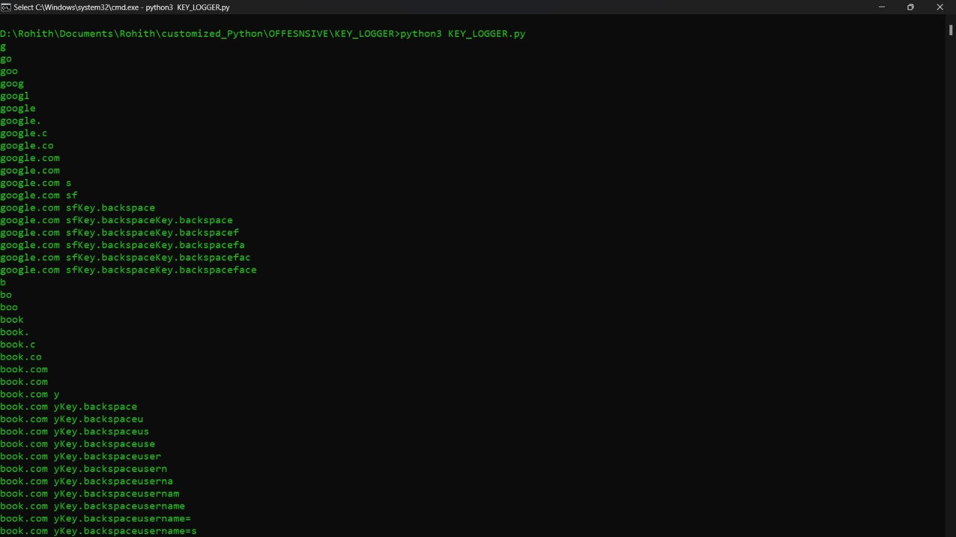
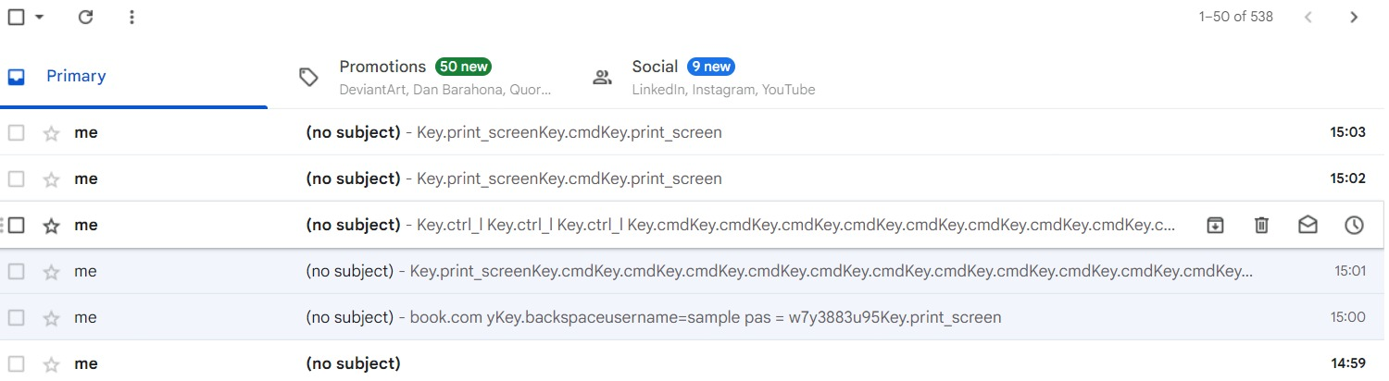
Result
Our testing endeavors culminated in favorable outcomes, underscoring the efficacy of our solution in capturing keyboard inputs.

Slide 10
Conclusion
The keylogger project delivers a robust solution for capturing keystrokes with enhanced security features. Through encryption, secure storage, and access controls, it ensures privacy and data security while complying with legal and ethical standards. Continuous improvement and adherence to regulations make it a valuable tool for legitimate monitoring purposes.

Slide 11
Future scope
Advanced Encryption : Implementing cutting-edge encryption techniques such as post-quantum algorithms for heightened data security.
Behavior Analysis : Utilizing machine learning to detect anomalies in keystroke patterns, enhancing threat detection capabilities.
Cloud Integration : Enabling secure data synchronization with cloud services for remote access and management.
Mobile Support : Extending compatibility to mobile platforms like iOS and Android, accompanied by tailored security features.
Remote Management : Implementing centralized dashboards for remote configuration and monitoring, facilitating easier management of the keylogger across devices and locations.

Slide 12
References
Smith, J. et al. (20XX). "Advanced Techniques for Keylogger Detection and Prevention." Journal of Cybersecurity, 10(2), 123-140.
Johnson, A. (20XX). "Machine Learning Approaches for Keystroke Anomaly Detection." Conference on Information Security, Proceedings, 55-67.
Patel, R. (20XX). "Practical Python Programming for Security Applications." O'Reilly Media

Slide 13
THANK YOU
Project Link

